Slide 1
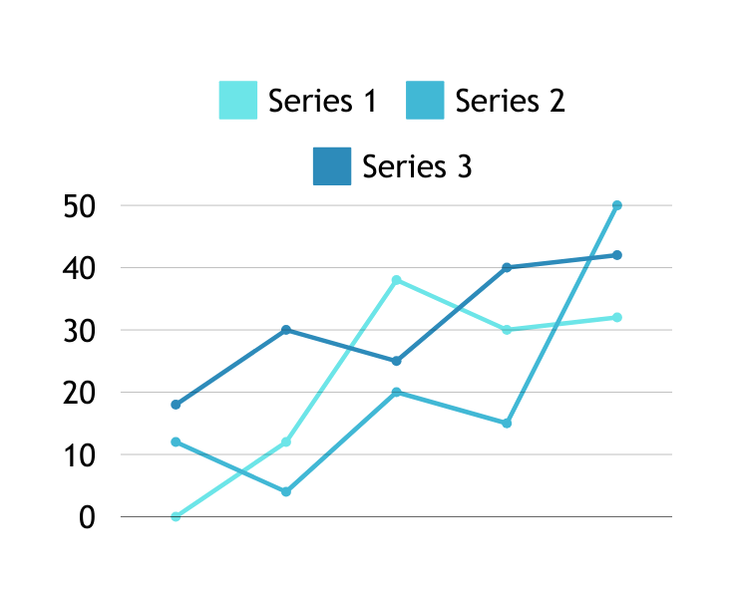
Middle Presentation: Time Series Forecasting
NAOL SAMUEL EREGA
Jan 17 ,2 0 2 5

Slide 2
Table of Contents
Problem Definition
Literature Review
System Details & Experiments
<Exp0: Statistical Models>
<EXP1: ML Models>
<Exp2: MLP Models>
<Exp3: Sequential Models>
1

Slide 3
Problem Defnition
Objective
Predict road surface temperature 8 hours in advance using available dataset.
Time Series Dataset
Features | Description
obj_temp | Pavement’s Temperature
atm_temp | Atmospheric Temperature
humi | Humidity Levels
pres | Atmospheric Pressure
2

Slide 4
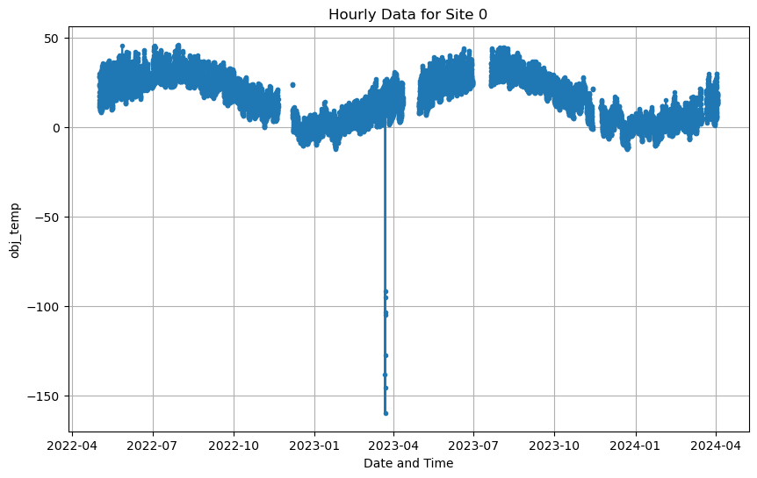
Literature Review
The problem of time series
Long term/ Short term
Univariate/ Multivariate
Time series dataset
Stationary/ Non-stationary
Seasonal/ Non-seasonal
Challenges
Missing data
Outliers
Non-stationarity
Fig 1: Missing, Outlier Example.
[1] Casolaro, Angelo, et al. "Deep learning for time series forecasting: Advances and open problems." Information 14.11 (2023): 598.
[2] Tabrizi, Sepideh Emami, et al. "Hourly road pavement surface temperature forecasting using deep learning models." Journal of Hydrology 603 (2021): 126877.
3

Slide 5
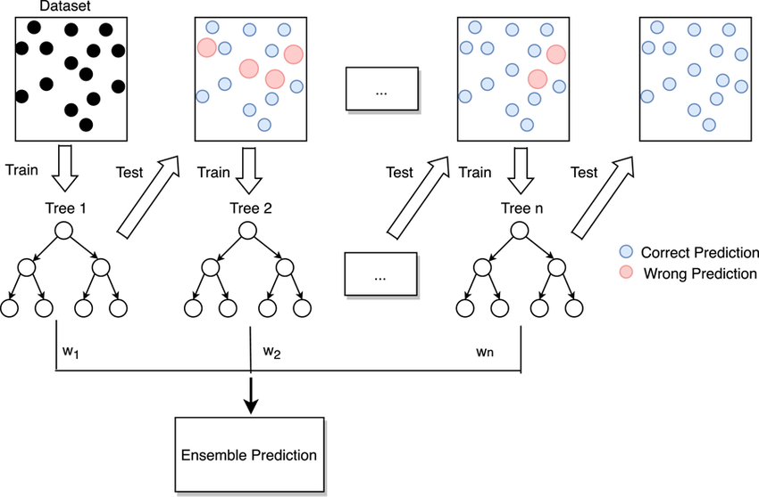
Methods of Prediction
Traditional Statistical Models
Rely on intrinsic dataset’s statistics.
Differencing to keep statistics stationary.
Example: AR, MA, ARIMA(AR +MA), SARIMA, STL.
Machine Learning(ML) Models
Expects tabular data as input.
So, lagged information as features.
Then, forecasting is treated as simple
regression task.
Example: KNN, Random Forests, Boosting
Machines (XGBoost, LightGBM).
Fig 2: Boosting Algorithm.
[3] Fattah, Jamal, et al. "Forecasting of demand using ARIMA model." International Journal of Engineering Business Management 10 (2018): 1847979018808673.
[4] Natekin, Alexey, and Alois Knoll. "Gradient boosting machines, a tutorial." Frontiers in neurorobotics 7 (2013): 21.
4

Slide 6
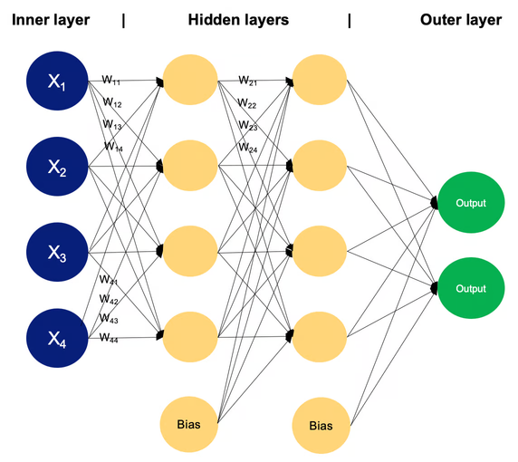
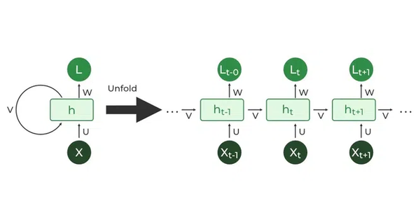
Cont’d
Multi-Layer Perceptron(MLP) Models
In terms of input, much like ML models.
But stacked layers to capture more
temporal information and non-linearity.
Example: N-Beats.
Sequential Models
Hidden states to capture temporal dependency.
Effective for long/short-term dependencies.
Example: RNN, LSTM, GRU.
Fig 3: MLP Architecture.
Fig 4: RNN Architecture.
[1] Casolaro, Angelo, et al. "Deep learning for time series forecasting: Advances and open problems." Information 14.11 (2023): 598.
[5] Graves, Alex, and Alex Graves. "Long short-term memory." Supervised sequence labelling with recurrent neural networks (2012): 37-45.
5

Slide 7
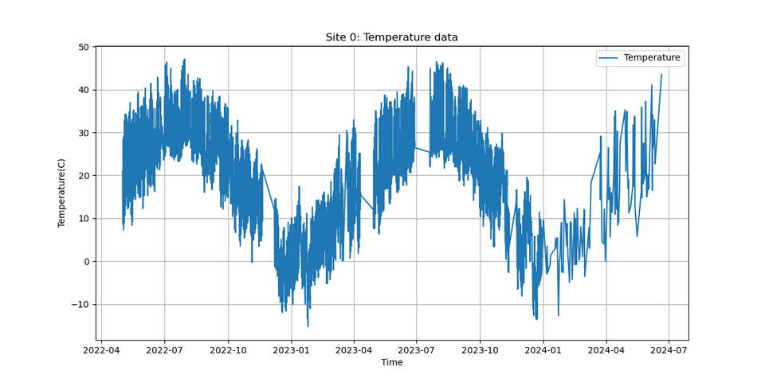
<Exp0: Statistical Models>
Objective
Explore Auto-SARIMA for univariate obj_temp prediction.
Dataset
Hourly obj_temp for site 0.
Total Observations: 12,760.
Train-Test Split: 90%-10%.
Fig 5: Site 0's obj_temp plot.
[8] Prashant. (n.d.). ARIMA Model for Time Series Forecasting. Kaggle. https://www.kaggle.com/code/prashant111/arima-model-for-time-series-forecasting
6

Slide 8
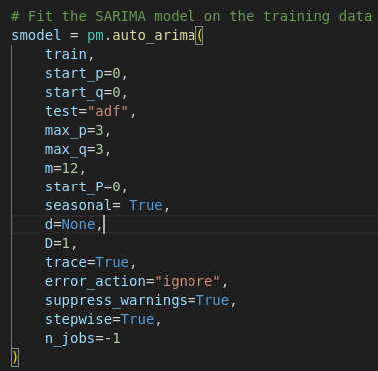
Cont’d
Model Setup: Auto-SARIMA
Automatic parameter tuning (p, q, d, P, Q, D, m).
Uses ADF Test for stationarity and AIC for model selection.
Seasonal Component: Periodicity (m) set to 12.
Parameters Searched: ARIMA (p, d, q)= 0–3 & Seasonal (P, D, Q)= 0–3.
Results
Best Model Selected: SARIMA(2, 0, 1) x (2, 1, 2, 12)
Performance: AIC(43704.835), BIC(43763.615),
RMSE(15.64)
Insights
Temporal gaps should be carefully handled !!
Statistical models struggle with complex time series,
such as pavement temperatures.
Significant training time per site.
Fig 6: Auto-SARIMA model setup
[8] Prashant. (n.d.). ARIMA Model for Time Series Forecasting. Kaggle. https://www.kaggle.com/code/prashant111/arima-model-for-time-series-forecasting
7
Notes:
-Uses the Augmented Dickey-Fuller (ADF) test to assess stationarity and the Akaike Information Criterion (AIC) for model selection.
-Seasonal periodicity (𝑚) is set to 12, corresponding to monthly seasonality.
-p (AutoRegressive Order):
-d (Differencing Order)
-𝑞 (Moving Average Order):

Slide 9
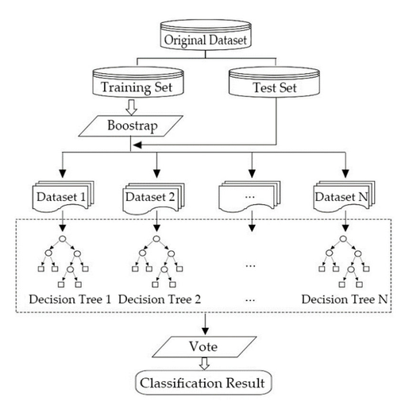
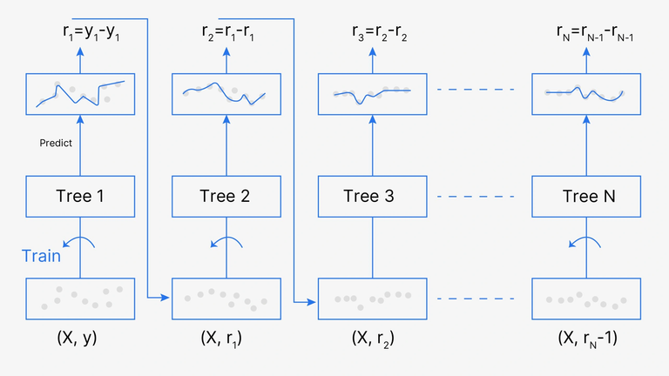
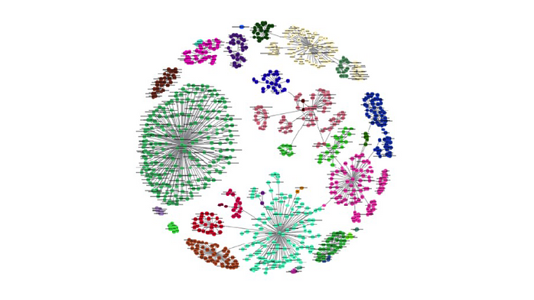

<Exp1: ML Models>
Tried Regressor Models:
Gradient Boosting Variants:
Example: CatBoost, XGBoost, LightGBM
Random Forest: Decision trees on bootstrapped dataset.
KNN: Stores the entire training dataset & Euclidean distance during inference.
Hyperparameters tuning: Grid search.
Fig 7: Random Forest Pipeline.
Fig 8: Gradient Boosting Pipeline.
Fig 9: KNN System.
8
[4] Natekin, Alexey, and Alois Knoll. "Gradient boosting machines, a tutorial." Frontiers in neurorobotics 7 (2013): 21.
[9] Cover, Thomas, and Peter Hart. "Nearest neighbor pattern classification." IEEE transactions on information theory 13.1 (1967): 21-27.
[10] Breiman, Leo. "Random forests." Machine learning 45 (2001): 5-32.

Slide 10
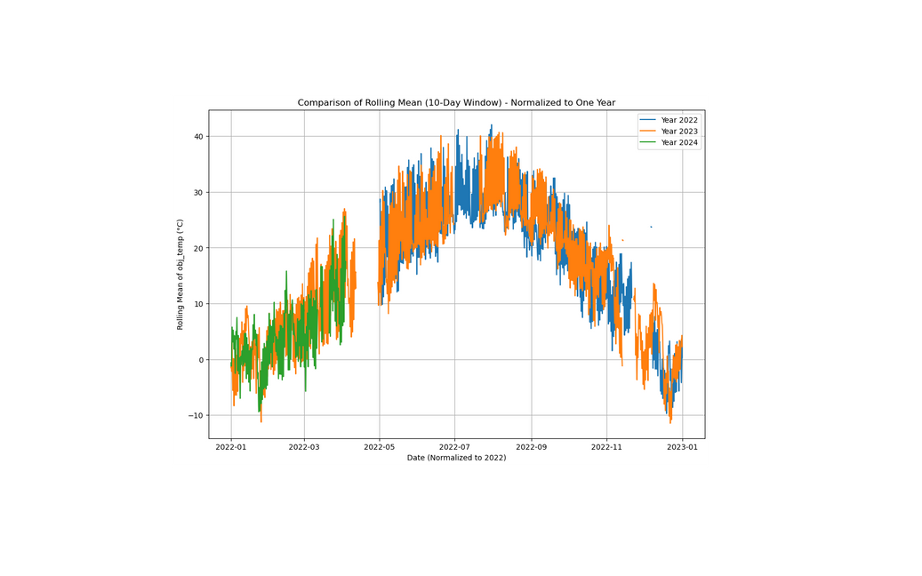
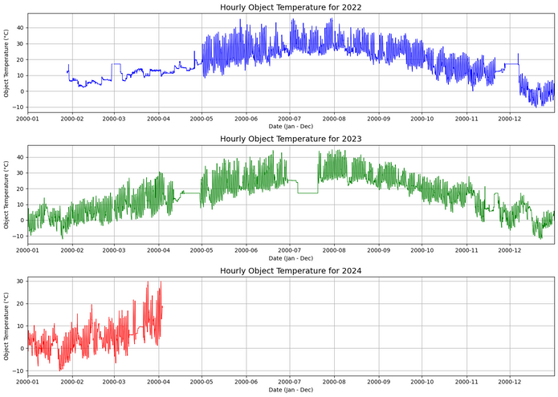
Cont’d
Data Preprocessing: Missing rows
EDA founds missing rows.
PyPOTS’s imputation models tried. But no good result because of long temporal gap.
So temporal batching, preprocessing & concatenation afterward.
Fig 10: Before Imputation.
Fig 11: After Imputation.
[6] Mastering Exploratory Data Analysis (EDA): Everything You Need To Know | by Sze Zhong LIM | Data And Beyond | Medium
[7] Data Imputation Demystified | Time Series Data | Ahmed Abulkhair| Medium
9

Slide 11
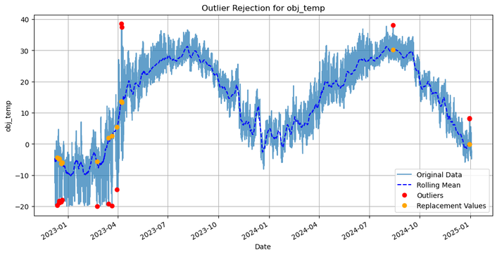
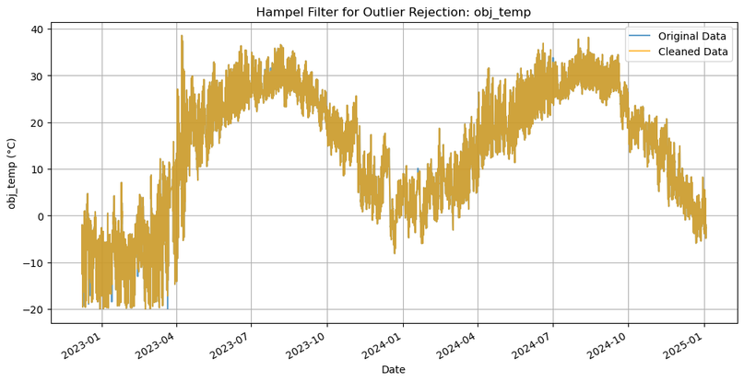
Cont’d
Data Preprocessing: Outlier Removal
Box plots for outlier identification.
Two algorithms ensembled for removal.
Z-Score Criteria(Adaptive)
Hampel Filter
Fig 12: Z-Score based outlier removal.
Fig 13: Hampel Filter based outlier removal.
[6] Mastering Exploratory Data Analysis (EDA): Everything You Need To Know | by Sze Zhong LIM | Data And Beyond | Medium
[7] Data Imputation Demystified | Time Series Data | Ahmed Abulkhair| Medium
10

Slide 12
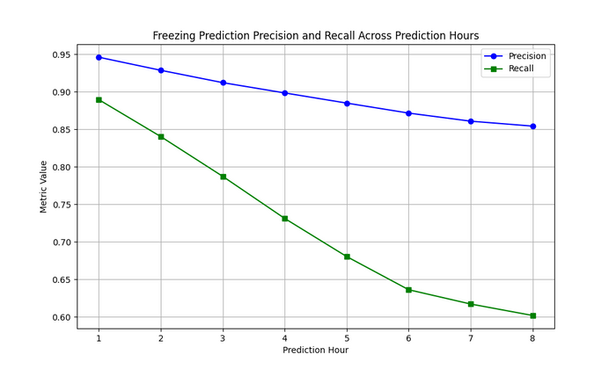
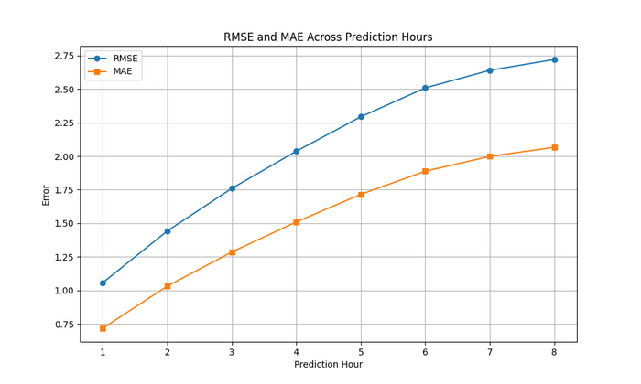
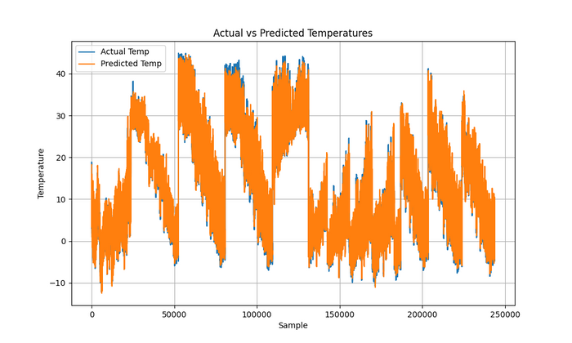
Cont’d
Metrics:
Precision: % of actual sub-zeroes out of all predicted sub-zeroes.
Recall: % of correctly predicted sub-zeroes out of all actual sub-zeroes.
Results: CatBoost
Fig 14: Sub-Zero Precision & Recall.
Fig 15: RMSE and MAE Plots for The Next 8 Hours.
Fig 16: Actual vs Predicted Obj Temperature.
11

Slide 13
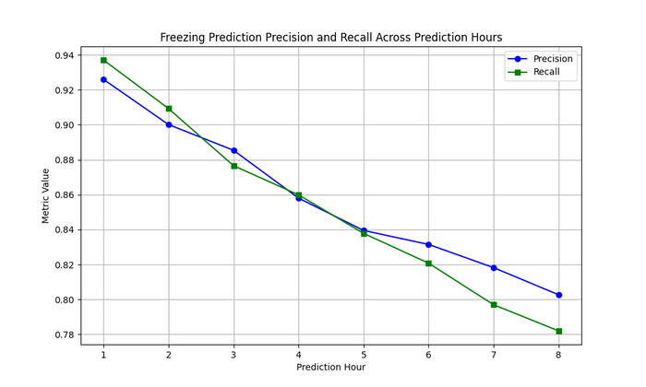
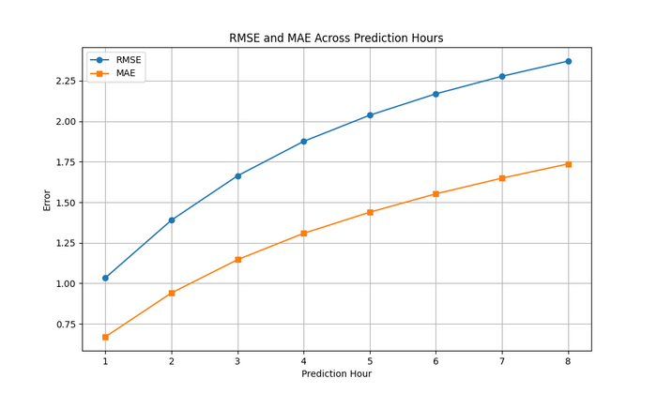

Cont’d
Results: XGBooster
Fig 17: Sub-Zero Precision & Recall.
Fig 18: RMSE and MAE Plots for The Next 8 Hours.
Fig 19: Actual vs Predicted Obj Temperature.
12

Slide 14
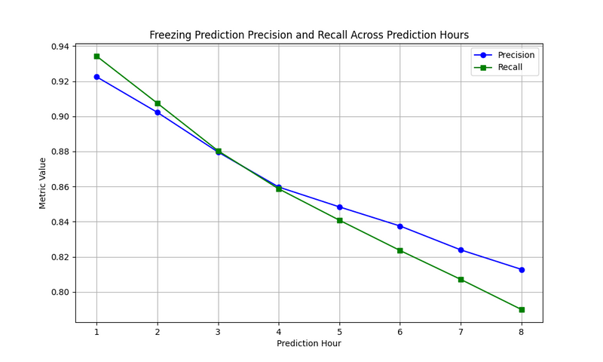
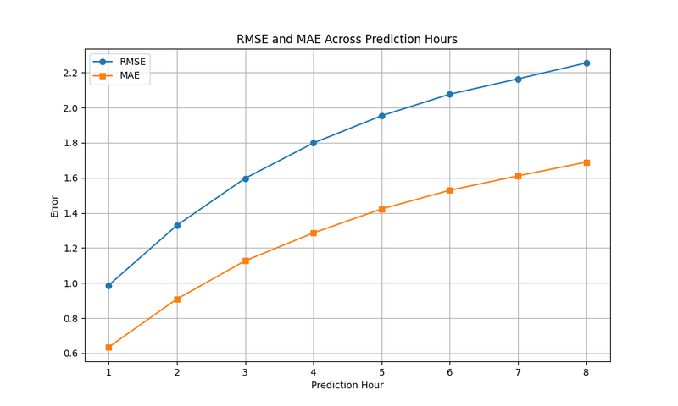

Cont’d
Results: RandomForest
Fig 20: Sub-Zero Precision & Recall.
Fig 21: RMSE and MAE Plots for The Next 8 Hours.
Fig 22: Actual vs Predicted Obj Temperature.
13

Slide 15
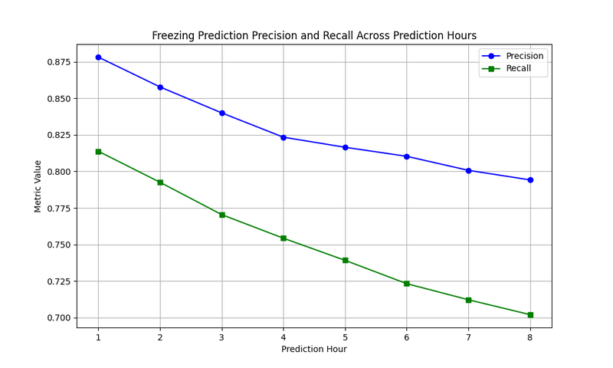
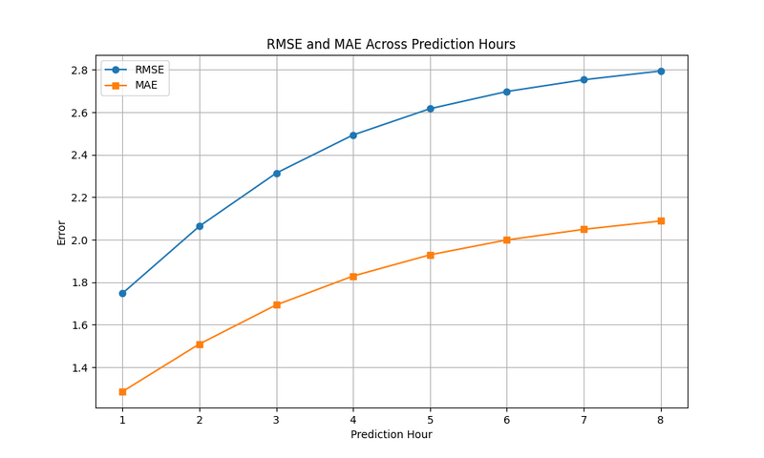
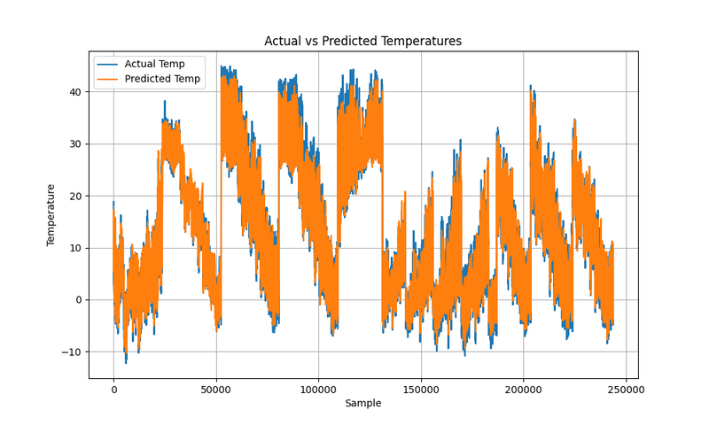
Cont’d
Results: KNN
Fig 23: Sub-Zero Precision & Recall.
Fig 24: RMSE and MAE Plots for The Next 8 Hours.
Fig 25: Actual vs Predicted Obj Temperature.
14

Slide 16
Cont’d
Results: ML Summary
Performance Metrics (Hour +8)
Model | Precision | Recall | RMSE | MAE
CatBoost | 0.85 | 0.60 | 2.72 | 2.06
XGBooster | 0.80 | 0.78 | 2.25 | 1.68
LightGBM | 0.79 | 0.71 | 2.18 | 1.61
Random Forest | 0.81 | 0.79 | 2.37 | 1.73
KNN | 0.79 | 0.70 | 2.79 | 2.08
15

Slide 17
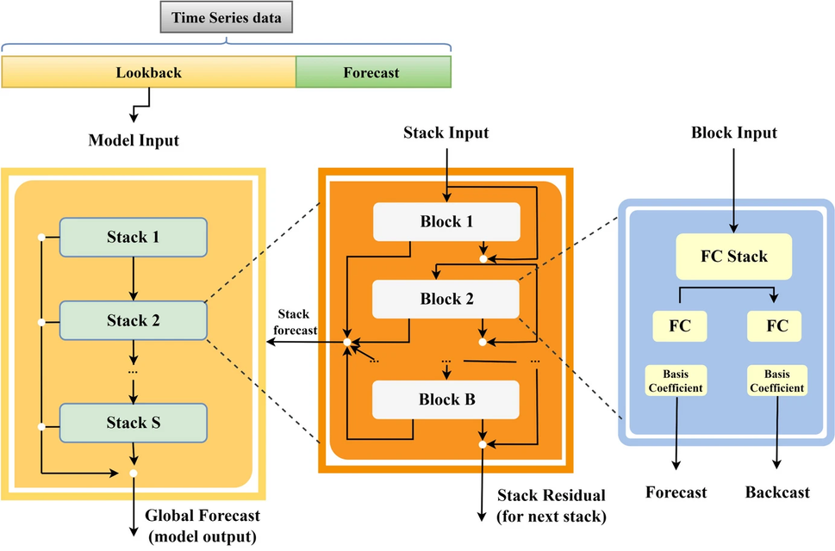
<Exp2: MLP Models>
Tried Models:
Custom N-Beats Like Architecture.
Model Architecture:
Fig 26: N-Beats Model Architecture.
[11] Oreshkin, Boris N., et al. "N-BEATS: Neural basis expansion analysis for interpretable time series forecasting." arXiv preprint arXiv:1905.10437 (2019).
[12] Srivastava, Pranav. "N-BEATS for Time Series Forecasting in a Simple Way." Medium, 4 Mar. 2020
16

Slide 18
N-Beats Components
Stacks
Multiple stacks, each specialize to capture
trends, seasonality or generic pattern.
Blocks
Each stack has multiple blocks.
Block has two outputs:
Backward forecast
Forward forecast
Backward forecast for residual calculation
that is used as input for the next block.
Aggregation of each forward forecast= stack forecast.
Fig 27: N-Beats Model Architecture.
[11] Oreshkin, Boris N., et al. "N-BEATS: Neural basis expansion analysis for interpretable time series forecasting." arXiv preprint arXiv:1905.10437 (2019).
[12] Srivastava, Pranav. "N-BEATS for Time Series Forecasting in a Simple Way." Medium, 4 Mar. 2020
17

Slide 19
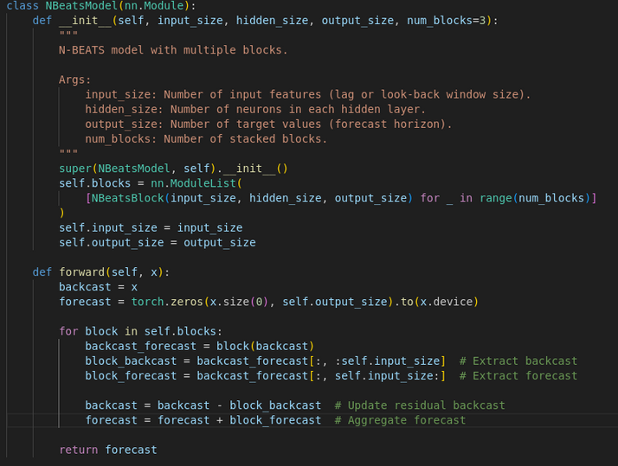
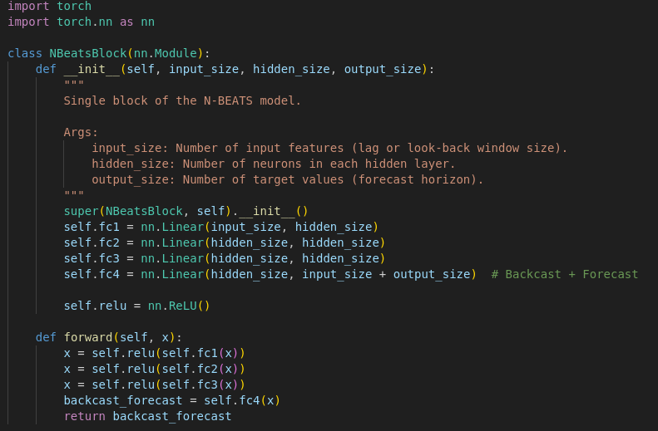
N-Beats Custom Implementation
Single stack used
3 Blocks in a stack
Fig 28: Designed Custom N-Beats Stack.
Fig 29: Custom N-Beats Stack’s
Block.
18
[11] Oreshkin, Boris N., et al. "N-BEATS: Neural basis expansion analysis for interpretable time series forecasting." arXiv preprint arXiv:1905.10437 (2019).
[12] Srivastava, Pranav. "N-BEATS for Time Series Forecasting in a Simple Way." Medium, 4 Mar. 2020

Slide 20
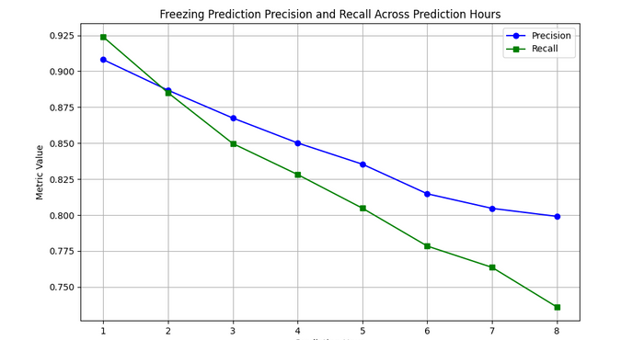
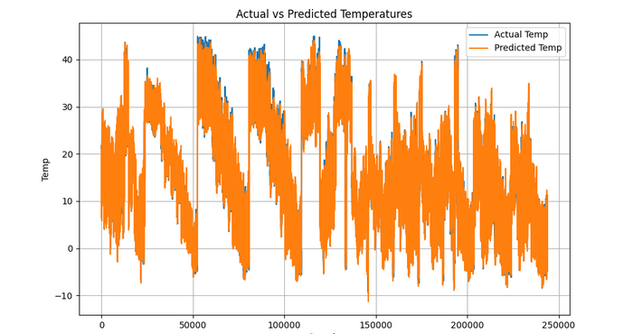
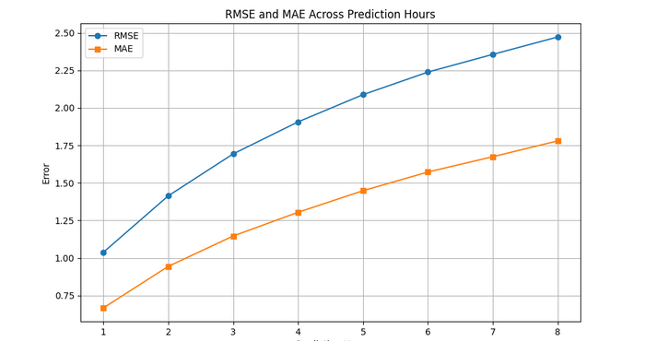
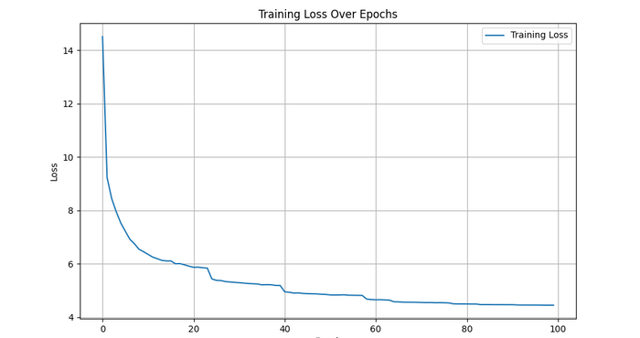
Cont’d
Results: N-Beats
Fig 30: Custom N-Beats Performance.
19

Slide 21
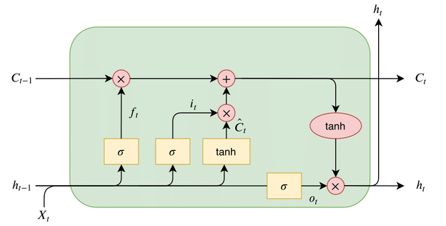
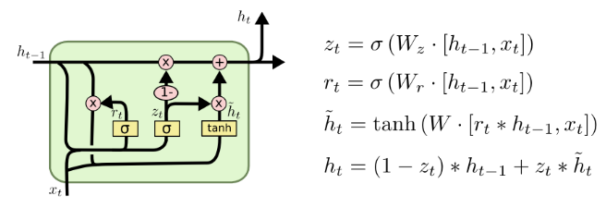
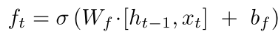
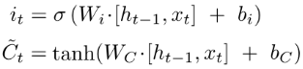
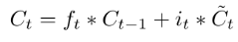
<Exp3: Sequential Models>
Tried Models
LSTM
“forget” gate= decides past information to forget.
“input” gate= decides new information to keep.
outputs= hidden and memory vectors.
GRU
“forget” +“input” gates = “update” gate.
“cell state” and “hidden state” merged.
output= only hidden vector.
Fig 31: LSTM Architecture.
Fig 32: GRU Architecture.
[5] Graves, Alex, and Alex Graves. "Long short-term memory." Supervised sequence labelling with recurrent neural networks (2012): 37-45.
[13] Olah, Christopher. "Understanding LSTMs." colah's blog, August 2015
20

Slide 22
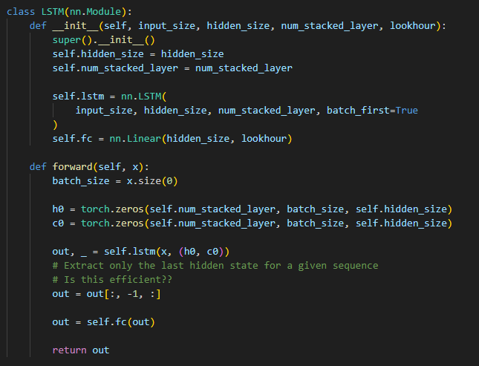
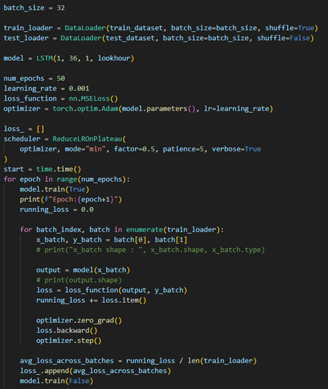
Cont’d
Experiment
Input Data: Preprocessed and reshaped into (Batch_Size=32, Seq_Len=31, Features=1)
Model:
Input Size: 1 feature.
Hidden Size: 36 dimensional hidden units.
Number of Layers: 1 layer (single stacked LSTM).
Output Size: 8 (predicting 8 hours ahead for each sequence)
Fig 33: LSTM-Model.
Fig 34: LSTM-Test.
21

Slide 23
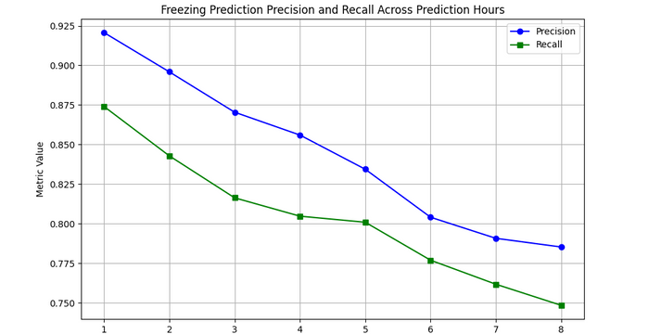
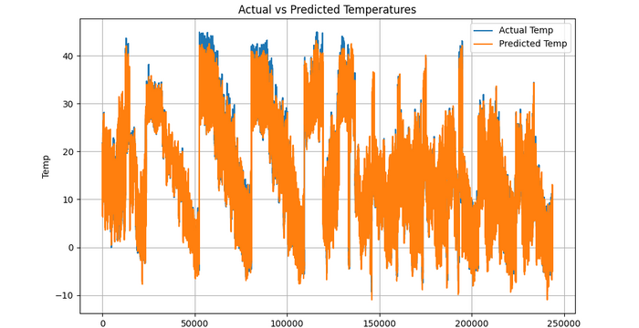
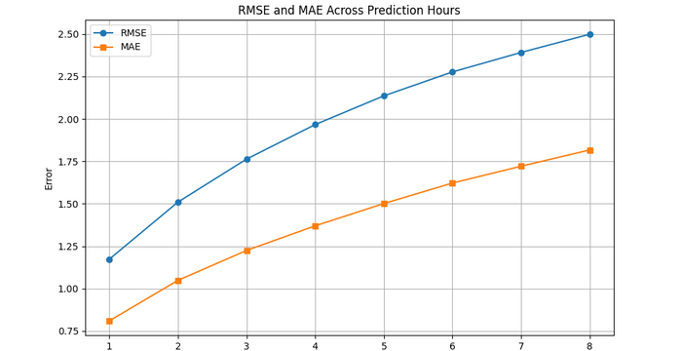
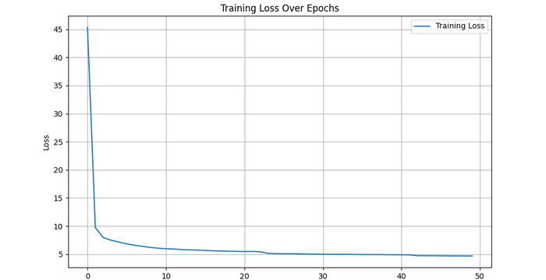
Cont’d
Result: LSTM
Fig 30: LSTM Performance.
22

Slide 24
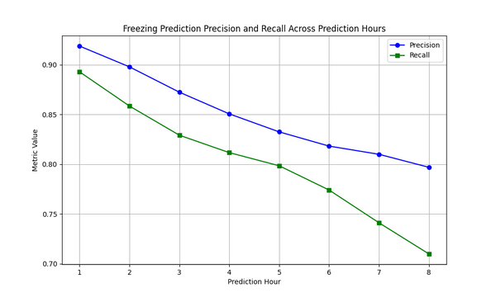
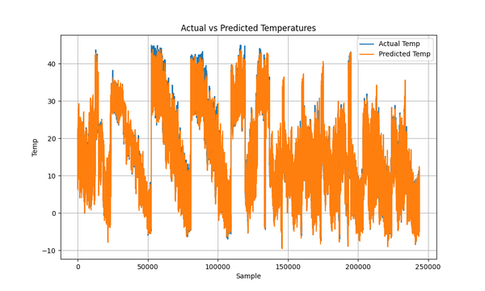
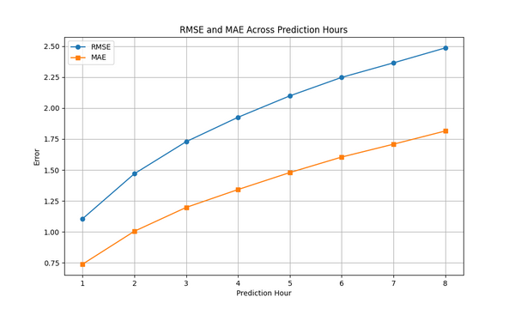
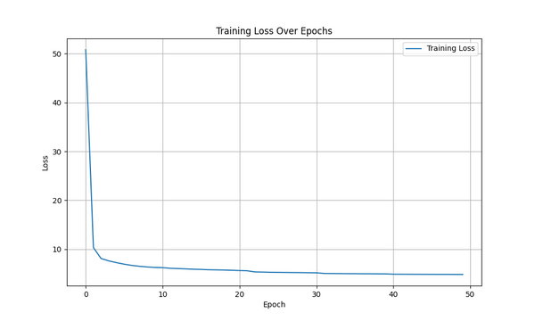
Cont’d
Result: GRU
Fig 31: GRU Performance.
23

Slide 25
Cont’d
Results: Deep Learning Summary
Performance Metrics (Hour +8)
Model | Precision | Recall | RMSE | MAE
Custom N-Beats | 0.80 | 0.73 | 2.43 | 1.76
LSTM | 0.79 | 0.75 | 2.50 | 1.81
GRU | 0.80 | 0.71 | 2.50 | 1.78
15

Slide 26
Second Half Plans
Ensemble the models to make them more robust.
Reframe the task as a classification problem instead of a regression task.
Explore other research areas of the company.
24

Slide 27
Thank You!

